Slide 1






COMPANY EMAIL CHAT REPLAY BOT
Introduction to Robotic Process Automation
22070110
JITHEESWARAN V
JINU SOPHIA
BE CSE B

Slide 2

Abstract
The Company Email Chat Replay Bot using Sentiment Analysis in UiPath automates email responses by analyzing the sentiment of incoming messages. It utilizes natural language processing to assess whether a message is positive, negative, or neutral and generates an appropriate reply. The bot improves customer engagement by personalizing responses based on the sentiment, enhancing efficiency in handling customer communications.

Slide 3
Need for the Proposed System
Email Integration: The bot automatically fetches incoming customer emails via IMAP and processes the content for sentiment analysis.
Sentiment Analysis: Utilizes natural language processing to
analyze the tone of emails (positive, negative, or neutral) using a sentiment analysis model.
Automated Response Generation: Based on sentiment, the bot generates tailored replies (e.g., friendly for positive,
empathetic for negative, neutral for standard inquiries).
UiPath Automation: UiPath Studio automates the workflow of fetching emails, analyzing sentiment, and sending responses, while UiPath Orchestrator monitors and schedules tasks.
Efficiency and Personalization: The bot enhances customer
engagement by delivering quick, personalized responses, reducing manual effort and improving response times.

Slide 4
Advantages of the Proposed System
Enhanced Customer Experience
Delivers personalized, empathetic, and prompt responses based on sentiment, improving customer satisfaction and trust.
Increased Efficiency and Cost Savings
Automates email handling, reducing response time and operational costs while enabling 24/7 support for unlimited scalability.
Actionable Insights
Provides sentiment analysis trends and customer feedback insights, helping businesses identify pain points and improve services.
Consistency and Flexibility
Ensures consistent tone and accuracy in responses while supporting multiple languages and customizable prompts for diverse business needs.

Slide 5
Literature Survey
Paper 1: Blockchain Technology: Applications, Benefits, and Limitations
Advantages: Decentralization, transparency, and enhanced security.
Disadvantages: Scalability challenges and high energy usage.
Paper 2: The Role of Social Media in Marketing and Communication
Advantages: Targeted marketing and user engagement.
Disadvantages: Privacy risks and dependence on algorithms.

Slide 6
Main Objective
Improved Customer Experience: Respond empathetically and efficiently based on the detected sentiment (positive, neutral, or negative).
Operational Efficiency: Automate the email response process, reducing manual intervention and response time.
Data-Driven Insights: Provide sentiment trends and actionable feedback to improve service quality and decision- making.
Scalability and 24/7 Support: Handle high email volumes consistently, ensuring no customer query is overlooked.

Slide 7
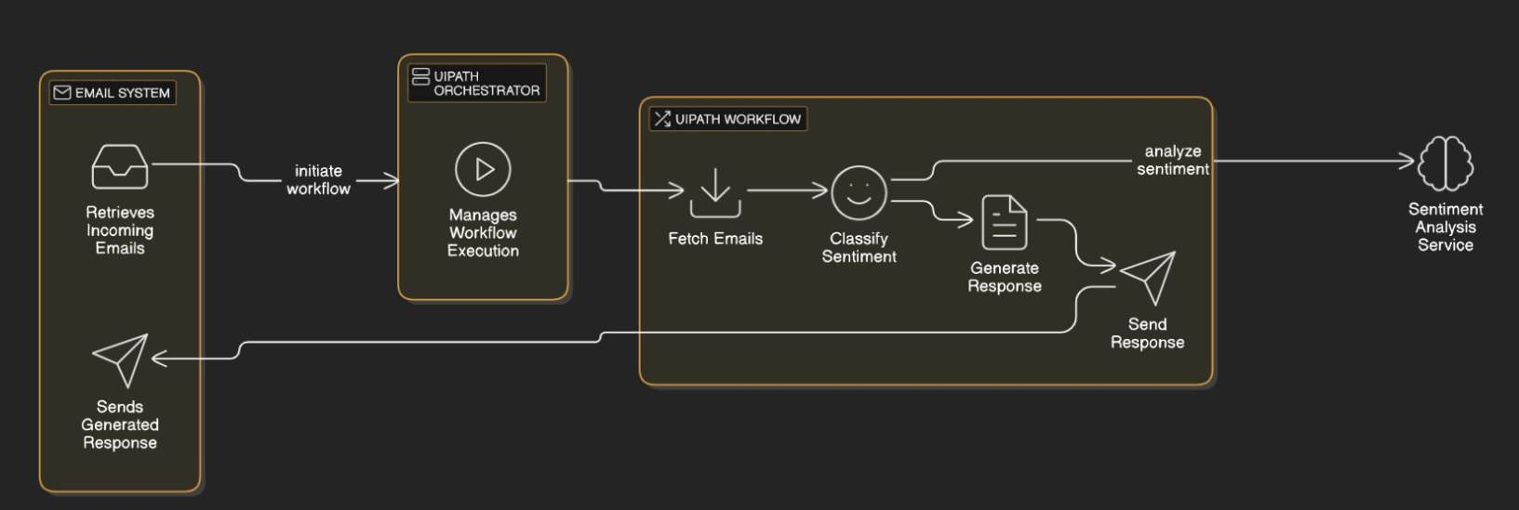
Architecture

Slide 8
System Requirements
Hardware:
Minimum: 8 GB RAM, 50 GB storage, 2.0 GHz dual-core CPU. Recommended: 16 GB RAM, SSD, and a 3.0 GHz quad-core CPU for better performance.
Software:
UiPath Studio (latest version), Windows 10/11 (64-bit), .NET Framework 4.6+.
Email integration with IMAP/SMTP (e.g., Gmail, Outlook).

Slide 9
Functional Description
Name of the Module 1
Short description
DFD / Activity Diagram
Name of the Module 2
Short description
DFD / Activity Diagram

Slide 10
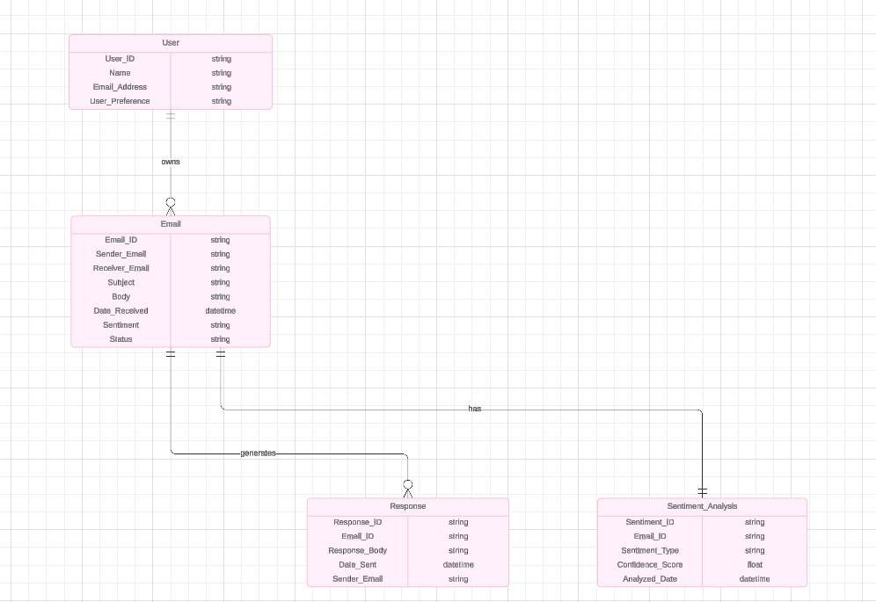
Table Design
ERD

Slide 11
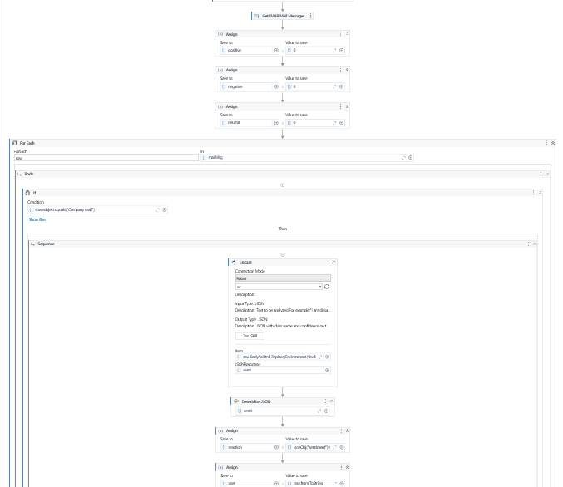
Workflow

Slide 12
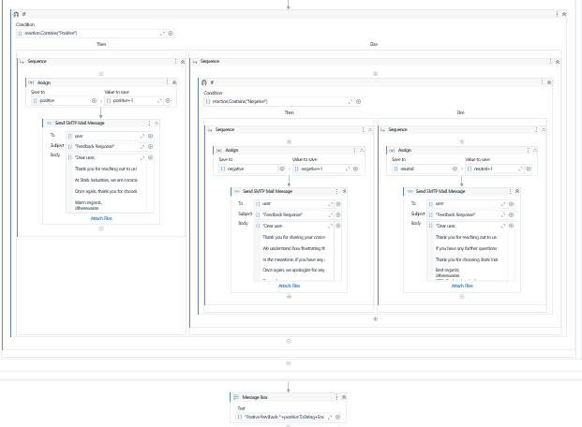
Workflow

Slide 13
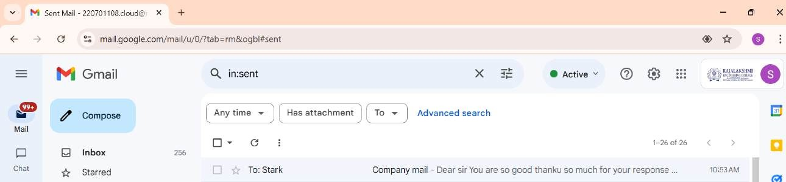

Testing
Mail sending
Mail received

Slide 14
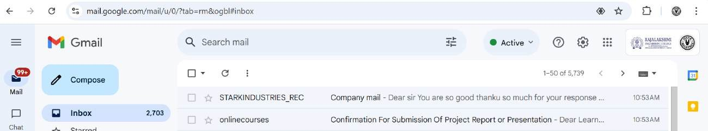
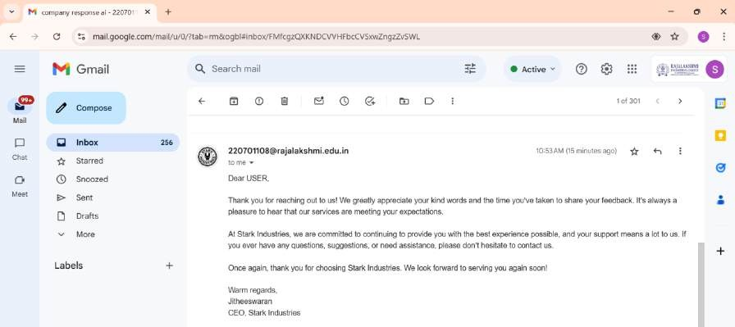
Testing
Mail read
Mail replay
▪

Slide 15
Conclusions
The automated email sentiment analysis and response system simplifies customer communication by streamlining the process of understanding and replying to emails. This approach ensures timely, consistent, and appropriate responses, improving customer satisfaction and reducing manual effort.
With its user-friendly design and efficient workflow, the system is a practical solution for handling large volumes of customer interactions effectively. It also lays the foundation for future improvements and integration with other automation tools.

Slide 16
Future Enhancement
Using chatgpt response
Ai based appointment can be done

Slide 17
IEEE Paper
Title: Sentiment Analysis for Automated Email Response System
https://ieeexplore.ieee.org/abstract/document/8737827

Slide 18
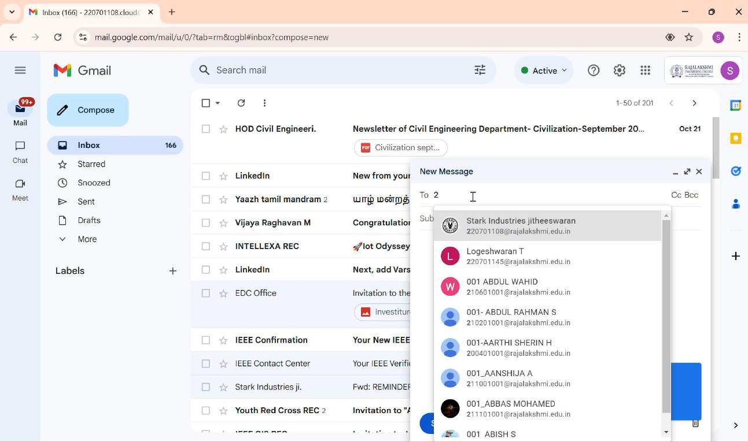

Slide 19

Thank You

